Slide 1
Taprint

Slide 2
ABSTRACT:
Why:
Limited security in smart watches
Widespread popularity
How:
Secure text input on the back of the hand
Tapping vibrations as biometrics
Virtual 12-key pad
Notes:
user’s tappingon-knuckle represents a consistent feature, which can be sniffed by the wristband’s inertial measurement unit (IMU).
Many smart watches have experienced data breaches as suffered consequences such as personal data leakage and payment fraud
Popular for fitness tracking or smartphone linking
Traditional verification (such as keypads) are vulnerable to shoulder surfing or smudge attacks
Face regocgnition and fingerprinting requires specialized hardware which does not fit the watches form and is vunerable to forgery attacks

Slide 3
CHALLENGES
Reading may be affected outside motion
Tapping signals are passive and unmodulated, comprised of a variety of frequencies
Hand biometry and tapping behavior may vary even for the same user over time.

Slide 4





TAPPING VIBRATION: ANALYSIS
Applied mathematical models to determine that tapping force can be uniquely identified
Notes:
Typical mathematical model of tapping is overly complicated for this situation

Slide 5
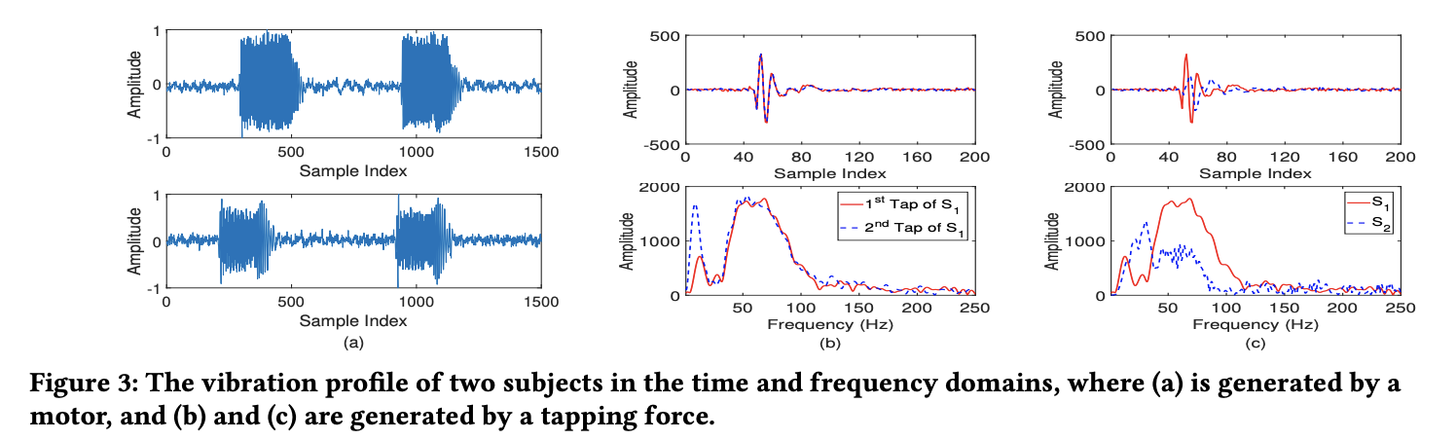
FEASABILITY: VIBRATION UNIQUENESS
Need to ensure that tapping vibrations are unique
Motor to test uniqueness of vibration waveforms
Fingers to observe matching/uniqueness of tapping signals in both frequency and time domains

Slide 6
FEASABILITY: DIFFERENT FINGERS
Need to ensure that the fingers are largely similar
Specifically, the back of the hand is the distinguishing factor
In-person experiment
Three conclusions
Euclidean distance of most authorized samples is smaller than that of the unauthorized samples
Euclidean distance of different fingers is about the same
some of the authorized samples mix with the unauthorized ones, which might be caused by the variation of the initial tapping force
Notes:
we asked 8 participants to tap on 14 knuckles of their left hands for 30 times using the forefinger, the middle fingers and the ring finger, respectively.
We calculate the average Euclidean distance between each datum point and other samples

Slide 7
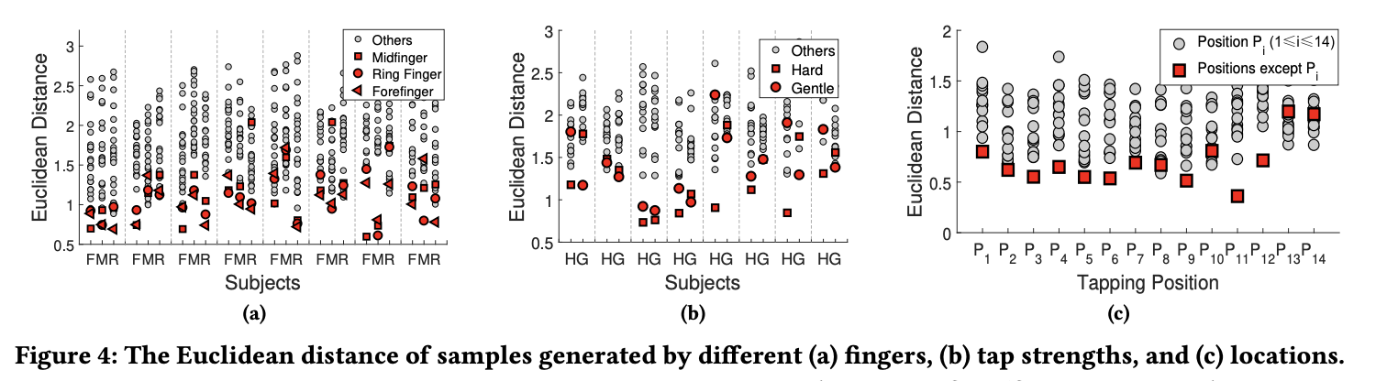
FEASABILITY: DIFFERENT FINGERS

Slide 8
FEASABILITY: VIBRATION STRENGTH
In-person experiment
Authorized samples with different tapping force may mix with the unauthorized ones
Needs addressing
Notes:
We asked 8 participants to tap on 12 knuckles of a hand for 30 times with both heavy and gentle force

Slide 9
FEASABILITY: VIBRATION LOCALITY
Need to ensure tapping locality could be distinguished
In-person experiment
Found that the Euclidean distance of samples on the same location is generally smaller than that of the others except 4 outliers
Inferred that the instability of initial tapping force results in these outliers.
Notes:
we asked one participant to tap on the 14 knuckles on the hand back each for 30 times.
we take the mean value of 20 samples collected from position Pi as datum point and calculate the average Euclidean distance between each datum point and other samples
it is evident that the value of y(t) is influenced by the variation of distance from the tapped position to a sensor

Slide 10
SYSTEM OVERVIEW
Tapping vibration detection
Segment with energy-based threshold
Align signals with GCC
Remove body noise
Z-score normalization
Fine-grained vibration recognition
design two kinds of weighted features for inputting numbers (text input and password input), and inputting single-tap for authentication
Custom nearest neighbor method and density-based one class classifier

Slide 11
SYSTEM OVERVIEW
Update and calibration
Simple, real-time manual calibration and a multi-threshold self-calibration mechanism for changing vibration features

Slide 12
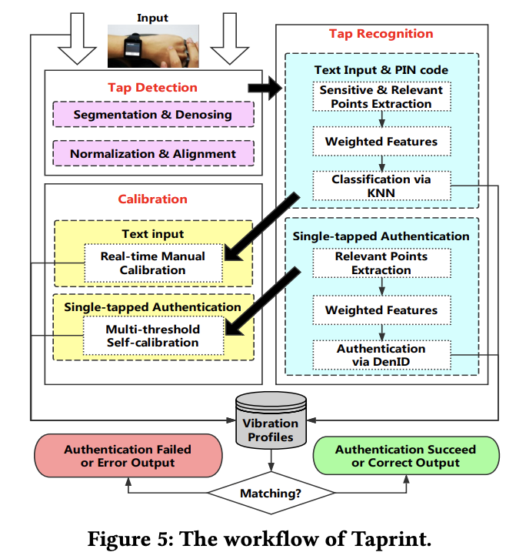
SYSTEM OVERVIEW: WORKFLOW

Slide 13
THREAT MODELS
Zero-effort Attack
Attack finds potential vibration signal to bypass authentication
Credential-aware Attack
attacker obtains the legitimate user’s credentials
Observer Attack
Attackers has prior knowledge of legitimate user’s PIN credentials and tries to imitate the behavior of the legitimate user
Intimate Attack
The attacker attempts to pass the authentication by tapping on the legitimate user’s hand when they are unaware of it
Notes:
the following attacks that may threaten the proposed authentication functionalities.
The attacker attempts to find a potential tapping location that can generate similar vibration signals to bypass the authentication by tapping randomly.
including the PIN code and the location of the single-tap lock.
However, attacker does not know the behaviors of the legitimate user such as tapping force, tapping angle, gesture, contact duration
tries to imitate the behavior of the legitimate user based on stealthy observations via shoulder surfing or camera recording
The attacker acquires knowledge of the legitimate user’s PIN code and the location of the single-tap lock. The attacker attempts to pass the authentication by tapping on the legitimate user’s hand when she is unaware of it

Slide 14
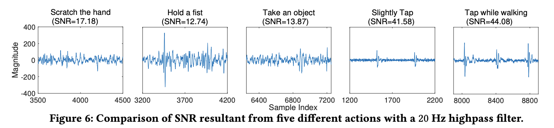
VIBRATION DETECTION: SEGEMENTATION/DENOISING
Segment vibration into windows
Use a cutoff point of 0.1s
Denoised signal using 20Hz Butterworth high pass filter.
vibration caused by human mobility is mostly less than 10 Hz
Induce segmentation when signal to noise ratio exceeds a certain threshold (defaulted to 20db)
To account for non-authentication activities

Slide 15
VIBRATION DETECTION: NORMALIZATION/ALIGNMENT
Normalize magnitude of signals using the Z-score normalization
standardized based on the mean and standard deviation of the original data
Align signals by finding the time shift with the GCC algorithm
Notes:
Note that Taprint does not utilize the Dynamic Time Warping (DTW) algorithm since it removes the timing information critical to the signal’s pitch and requires much more intensive computation.

Slide 16


FINE FEATURES: WEIGHTED FEATURES
Keypad input
needs to distinguish 12 tapping positions
use the Fisher score technique to identify position-sensitive frequency points and position-relevant frequency points
Single tap authentication
system only needs to identify whether the vibration is generated by a certain fixed position
position-relevant frequency points exhibit better characteristics
Notes:
the position-sensitive frequency points and the position-relevant frequency points jointly provide the feature information

Slide 17
FINE FEATURES: TAPPING POSITION
Keypad input
runs a nearest-neighbor-based pattern matching algorithm that compares the extracted features with those in the training set.
training data with minimum distance is declared as the current key position
Single tap authentication
Draws the boundary of the sample distribution; found to be unreliable
observed that the density of a sample set from the same position of a hand of the same user remains stable, which means that the pairwise distance between samples is similar.
Notes:
Note that Taprint cannot use sophisticated pattern recognition methods, like neural network, or support vector machines
These algorithms require substantial training
incurs formidable computational cost which hampers real-time tapping recognition
If the test sample is out of the edge, it is regarded as the unauthorized sample
examination of collected data shows that, most of the data from the same position has an irregular distribution instead of a circle distribution which leads to difficulty of drawing the edge of the samples distribution

Slide 18
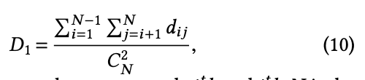
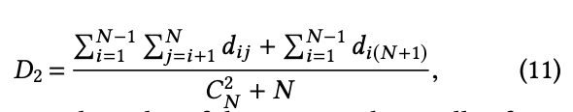
DenID
Density-based one-class classifier
If an unauthorized test sample is added to the authorized samples set, the density of the sample set decreases
If D₁> D₂ + th, the test sample is considered as unauthorized
A larger threshold means more false acceptance rate (FAR)
smaller threshold means more false rejection rate (FRR)

Slide 19
CALIBRATION: REAL TIME
Taprint displays top 2 candidate keys on the touch screen when a user types
Users can touch to choose the candidate key showing on the touchscreen and update this key to the training set when an error key occurs.
Implement a reset mechanism for the training set when users feel that the initial training set does not work anymore over time and requires one-time validation (like fingerprinting)
Notes:
we do not update the initial training set but update a copied training set in the memory
users may update an error key into the initial training set incautiously, which pollutes the initial training set
adversaries may insert the unauthorized samples into the training set

Slide 20
CALIBRATION: SELF CALIBRATION
Taprint guides users to input a variety of samples into the initial training set with different tapping force and slight deviations from the target position
Multi-threshold calibration
Notes:
Taprint cannot adopt the real-time update mechanism as adversaries may update and insert the unauthorized samples into the training set

Slide 21
CALIBRATION: FINE CLUSTERING
When two clusters are merged and the density is hardly changed, resultant two clusters are similar
Specifically, before the merging operation, the density of cluster C₁ is d₁, and the density of the new cluster after merging C₁ and C₂ is d₂
When d₂/d₁ is less than a certain threshold, these two clusters are considered as similar enough to be merged.
Threshold was set to 1.05

Slide 22
EVALUATION
Implemented Taprint as a standalone application program on the LG G Watch W100 with a 37.9 × 46.5 mm screen, 1.2 GHz Quad-Core processor, a RAM with 512 MB, 400 mAh of battery and Android Wear 1.0.5.
Utilizes the built-in accelerometer and gyroscope (InvenSense MPU6515)
Acquires the motion readings through existing Android Wear APIs to detect the finger tapped vibration

Slide 23
EVALUATION: WATCH MODIFICATION
The maximum sampling rate through the APIs is only 100 Hz
the frequency features of vibration signals caused by finger tapping should be from 10 Hz to 250 Hz, which requires at least 500 Hz Nyquist sampling rate
Modified kernel driver interface configures the IMU registers to realize the documented high-speed sampling allowable by the low-layer hardware.

Slide 24
EVALUATION: THE WATCH
A user interface was designed to guide the user to train and use Taprint
In the current implementation, the average end-to-end latency is 232 ms with a standard deviation of 26.5 ms from inputting the key to the display of the input
The initial training process lasts for about 1 mins.
Taprint only consumes an additional 48.2 mW level of power on top of the base power consumption
step calculation application has a power consumption of 288 mW

Slide 25
EVALUATION: EXPERIMENT
Recruited 128 participants (43 of them female) in age range between 19 and 26 whose body mass indexes (BMIs) are ranging from 17.16 to 29.28
To demonstrate the basic performance of Taprint, 113 participants were asked to tap on four random locations (4 knuckles) for the PIN code password, and 30 participants were asked to tap on all locations (12 knuckles), each for 30 times to generate the basic data set
some of the participants were asked to record the data under different experimental conditions, which will be specified
Each of the participants was designated as the legitimate user in turn to train the system, in the meanwhile the other subjects were set to be attacker

Slide 26
EVLAUATION: METRICS
VSR and AFR of PIN Code Authentication
The verification success rate (VSR) is defined as the success rate of inputting a complete PIN sequence by a legitimate user
attack failure rate (AFR) is defined as the failure rate of inputting a complete PIN sequence by an attacker
ROC Curve of Single-tap Authentication
FAR as the ratio between the number of falsely accepted attacker samples and the total number of attacker test samples
FRR as the ratio between the number of falsely rejected legitimate samples and the total number of legitimate test samples.
Obtained FAR and FRR pairs by adjusting the identification threshold and depict the receiver operating characteristic (ROC) curve, which shows the equal-error rate (EER) where the FAR is equal to the FRR

Slide 27
EVALUATION: ACCURACY
Baseline classification accuracy.
Taprint obtains an average accuracy of 95.64% for twelve keys.
when the training and test samples are from different users as shown, the accuracy is very low, which makes it difficult for adversaries to type with Taprint
Verification accuracy: PIN Code Authentication
The VSR reaches 94% with a single trial, rises to around 99.5% with two trials and then it approaches nearly 100%.
Verification accuracy: Single-tap Authentication.
On average, single-tap authentication obtains 1.29% false rejection rate (FRR) when the false acceptance rate (FAR) is 5%
Indicates that only 1.29% of the authorized subjects are rejected and 5% of the total subjects gain unauthorized access

Slide 28
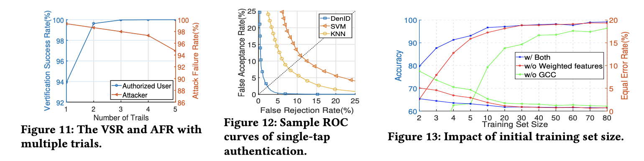
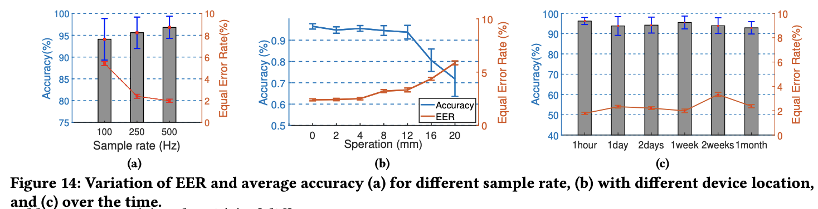
EVALUATION: ACCURACY

Slide 29
EVALUATION: ACCURACY
Verification accuracy: DenID
compare the outcome of our designed classifier DenID with that of the one class classifiers K-Nearest Neighbor (KNN) and Support Vector Machine (SVM)
when applying DenID, Taprint obtains a much lower EER at 2.4% than that of traditional classifiers (at around 8% for KNN and 11% for SVM)

Slide 30
EVALUATION: ACCURACY
Impact of Training Set Size: PIN Code Authentication.
the average classification accuracy is around 80% even with 2 initial training sample. The accuracy then escalates to above 98% on average when the training set size enlarges to 20.
Impact of Training Set Size: Single-tap Authentication.
As for the single-tap authentication, 2.7% equal error rate (EER) can be achievable on average with only 2 training instances for each user, and it further declines to below 1.0%

Slide 31
EVALUATION: ACCURACY
Sampling Rate
The average EER decreases from 5.4% at 100 Hz to 1.9% at 500 Hz. Moreover, the average classification accuracy are 94% and 96.8% with the 100 Hz and 500 Hz sampling rate, respectively

Slide 32
SECURITY ANALYSIS
Zero-effort Attack
recruited another 20 participants from our university as attackers to attack the 113
Each attacker was asked to randomly tap on his hand back for 40 times to generate the attack sample set.
results are consistent with our intuition that the random guesses are nearly impossible to pass through either the single-tap-based or the PIN code-based authentication even with 5 trials.

Slide 33
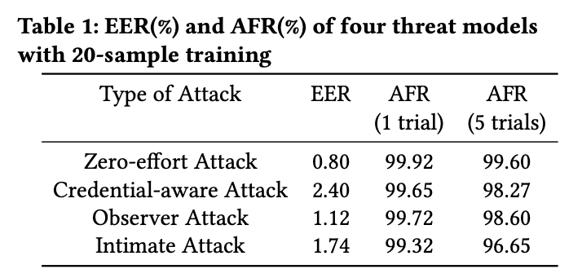
SECURITY ANALYSIS

Slide 34
SECURITY ANALYSIS
Credential-aware Attack.
Conducted experiment using the data collected from the 113 participants. Each participant was alternatively taken as the victim, and the remaining 112 participants playing as attackers
For PIN code authentication, there is a 99.65% chance for attackers to be blocked outside the system within a single trial, and the AFR only drops a little to 98.27% within 5 trials
For the single-tap authentication, the EER is 2.40%

Slide 35
SECURITY ANALYSIS
Observer Attack
Viedo-record the data collection process of 20 out of 113 participants, and demonstrate the videos to other 10 participants who act as attackers
The attackers were asked to mimic the tapping motion of victims. They were required to practice at least 10 times before generating 10 mimicry tap for each designated location
Under the observer attacks, the system also maintains high security (i.e., 98.6% five-trial AFR and 1.12% EER

Slide 36
SECURITY ANALYSIS
Intimate Attack.
Asked 5 attackers to tap on the four designated locations on the hand back of victims (each for 10 times) to generate the intimate attack dataset
Speculate that results come from the impact of behavioral variation which is difficult for attackers to mimic via their observation.
The experiment yielded 1.74% EER 99.32% AFR (1 trial) and 96.65% AFR (5 trials)

Slide 37
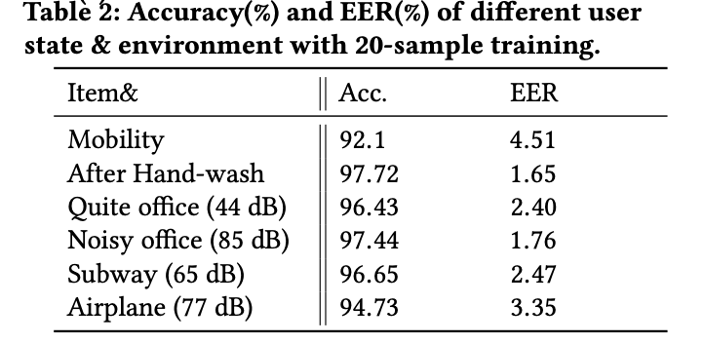
ROBUSTNESS

Slide 38
ROBUSTNESS
Strength of Tap.
Asked 15 participants to tap on each key 30 times both gently and heavily, resulting in 1920 responses
Accuracy drops to around 50% when the test tap force is different from the training tap force
Nonetheless, when THE classifier is built with both “heavy” and “gentle” data, the accuracy remains

Slide 39
ROBUSTNESS
Resilience to Displacement
Form an anchoring group when the smartwatch is worn at a fixed position, and then generate other 6 test positions, which deviate from the anchoring position by 2 mm to 20 mm
On average, the EER and classification accuracy suffers minor impact when the deviation of the smartwatch is less than 12 mm. Further deviation over 12 mm leads to an unacceptable degradation of system performance
17 participants were asked to consecutively tap on each key for 30 times, to be taken as the center point. Then, they were asked to tap another 30 times respectively with an interval of 5 mm from the center point.
The results show that our system is robust and suffer no impact with the spatial separation of 5 mm.

Slide 40
ROBUSTNESS
Arm Rotation
Collected data under three different gestures of wrist rotated:
(1) gesture 0 indicates the plane of hand back parallels to the ground
(2) gesture 1 indicates the arm rotate 45 degrees outwards from gesture 0
(3) gesture 2 indicates the arm rotate 45 degrees inwards from gesture 0
Collect the corresponding data of 18 participants from each location for 30 taps
The results show that the accuracy is not compromised by different arm rotations

Slide 41
ROBUSTNESS
User State
Mobility: A noise interference occurs due to the physical movement that users make in the usage process of Taprint.
Taprint still obtains a good performance with average accuracy at 92.1% and EER at 4.5%.
Hand-wash: Could cause a slight drift of underlying muscle tissue, which successively causes a change in the damping and elasticity coefficients.
is no impact on the performance of Taprint after having the users’ hand washed.
Notes:
The reason of good performance is that the human mobility only caused low-frequency noise (less than 10 Hz)[36] and we already have removed it through a Butterworth high pass filter with 20 Hz cutoff frequency

Slide 42
ROBUSTNESS
Different Environment
four scenarios: a quiet office environment (i.e., control group), noisy office with loud music, subway, and flying airplane.
The results demonstrate remarkably good performance comparing to the control group in a quiet office (96.43% average accuracy and 2.40% EER). It reveals that the authentication system is robust and reliable in different environments

Slide 43
ROBUSTNESS
Temporal Stability
Two experiments were conducted spanning over a month with 6 times recorded data at different time
In the first experiment, 8 participants were asked to tap 12 knuckles for 6 times, respectively, to initialize the speed dial for number input.
Participants test the speed dial by tapping each key 30 times. The results show that the accuracy is more than 95% over one month.

Slide 44
USER STUDY
Involves ten participants. Asked participants to initialize their PIN code, password lock, and pattern lock.The password was selected from the random numbers or the character table.
Each participant then answers the questions after performing all the methods in a random order. They were asked rank the five methods regarding the following four perspectives:
1) the speed of login
2) the easiness to memorize
3) the convenience to perform
4) the difficulty to cause the error

Slide 45
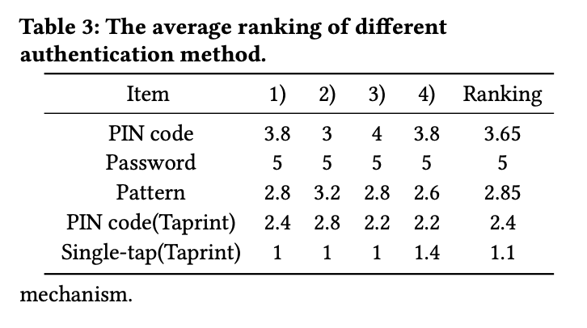
USER STUDY
In the cases of PIN code, password and pattern lock, the system incurs a certain cognitive load on users. On the contrary, users can tap precisely on the designated location without any thought when applying a single-tapped lock
Notes:
To summarize, Taprint is regarded as the faster, easier, more convenient and less error-prone one. Besides, it also earns higher acceptance compared to the existing methods

Slide 46
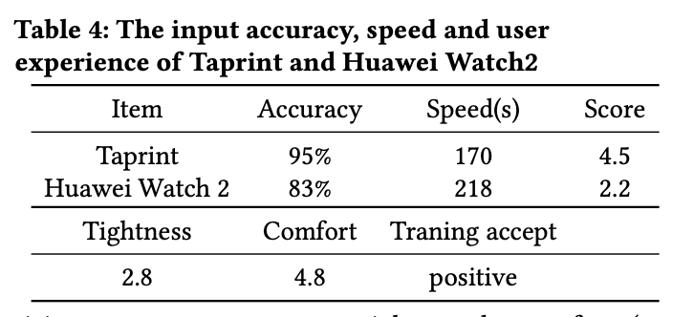
USER STUDY
Taprint utilizes the accelerometer and gyroscope on COTS smartwatch to detect the finger tap vibration signal, which usually requires the sensor to be well-contacted with users’ skin to obtain good quality data
Therefore, every participant was asked to grade their feeling about the tightness and comfort degree by launching two Likert-scale question

Slide 47
CONCLUSION
Address a secure text input system for a smartwatch by exploiting tapping-induced vibration signal
First to propose a novel secure text input system for smart wristbands solely relying on the motion sensors on a smartwatch, without requiring any extra hardware
Built an on-body tapping induced vibration model and verify its feasibility for secure input.
Implemented an efficient application running on COTS Android smartwatch and validated its performance through comprehensive examinations under some realistic attack scenarios
Related Work
Authentication Methods
Keystoke Recognition
Vibration Recognition

